Slide 1

Financial Cash Flow
Created By
Vrunda Patel

Slide 2
Financial Cash Flow Introduction
Welcome to our Financial Cash Flow Presentation. The purpose of today's discussion is to provide a detailed analysis of our financial landscape, examining key components such as Chart of Accounts, Payments, and Income.
By delving into these datasets, we aim to gain valuable insights into our cash flow dynamics, identify trends, and make informed decisions to enhance our financial health.
Join us on this journey as we explore the intricacies of our financial structure and unlock actionable strategies for sustainable growth.

Slide 3
Understanding our financial structure is paramount for strategic decision-making and long-term sustainability. The combination of Chart of Accounts, Payments, and Income forms the backbone of this understanding, offering a comprehensive view of our financial ecosystem.
Chart of Accounts: Provides a detailed roadmap of our financial architecture, outlining account categories, groups, and cash flow types. It serves as a foundation for precise financial reporting and budgeting.
01
Payments: The lifeline of our financial activities, tracking the flow of funds outwards. Analyzing payment data unveils expenditure patterns, identifies key providers, and aids in optimizing cash outflows.
02
Income: Illuminates the revenue side of our equation, showcasing customer transactions and income sources. Insight into income patterns is vital for forecasting, recognizing profitability, and strategic planning.
03

Slide 4
Chart of Accounts Overview
Account ID: Unique identifiers for each financial account, streamlining tracking and organization.
Category and Subcategory: Classifications providing a structured breakdown of accounts for clear financial reporting.
Groups: Grouping accounts based on shared characteristics, facilitating a comprehensive view of financial segments.
Cash Flow Type: Categorization of accounts into operational, investing, and financing activities, crucial for understanding cash movement.
Type: Specifies whether an account is an asset, liability, equity, income, or expense, providing insights into financial positioning.

Slide 5
Payment Overview
Issue Date and Due Date: Understanding the timeline of payment obligations, highlighting the period between issuing and due dates.
Settlement Date: Tracking when payments are settled, offering insights into payment cycle efficiency.
Chart Account ID: Linking payments to specific accounts, aiding in the detailed analysis of financial transactions.
Provider: Identifying key partners or vendors crucial for strategic relationship management.
UF (Unit of Function): Locational or departmental information for enhanced cost allocation.
Amount Paid: The financial impact of each payment transaction, providing a snapshot of cash outflows.

Slide 6


Here are some key Insights
Cash Flow Analysis
Income Tracking
Vendor and Customer Relationships
Financial Reporting and Budgeting
Strategic Decision-Making

Slide 7
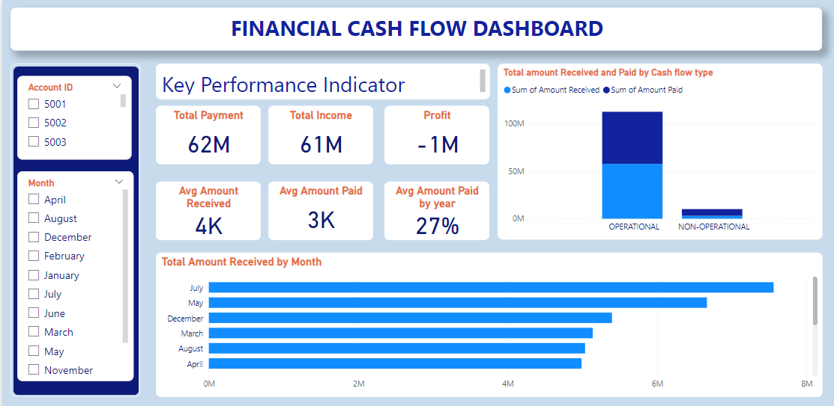

Slide 8
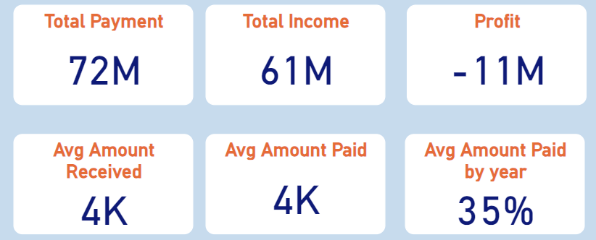
6 Key Performance Indicator
Total Amount Received
Total Amount Paid
Profit
AVG amount received
AVG amount paid
AVG amount paid by year

Slide 9
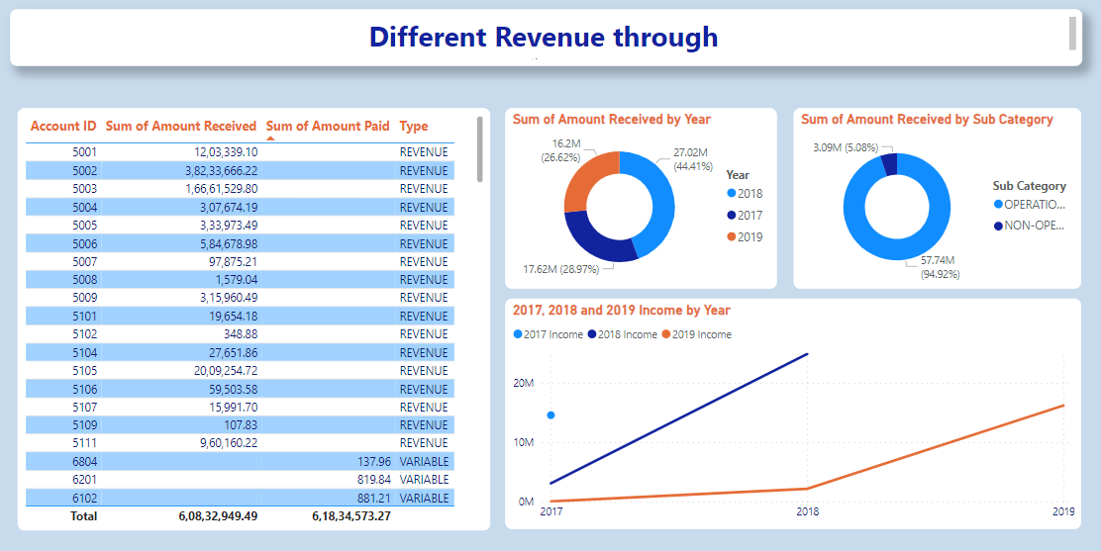

Slide 10
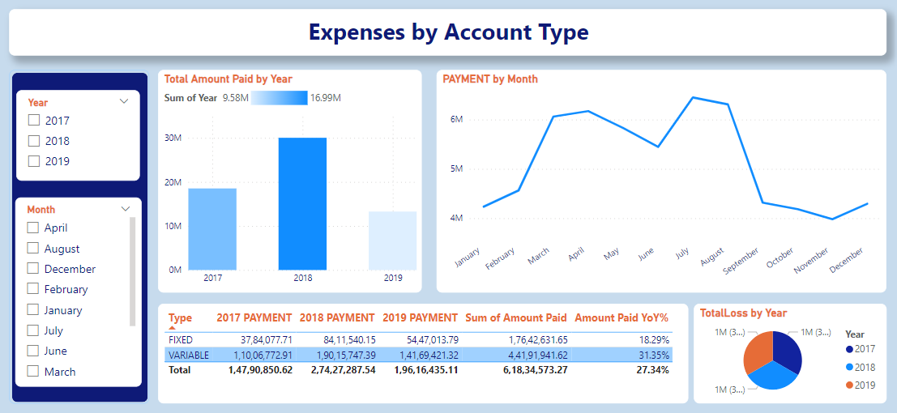

Slide 11
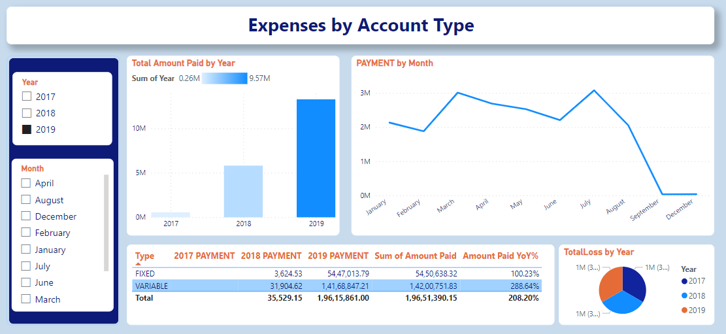
Here are some December financial analytics for payments received, Income received, profit made, payments received by month, and payments made by cash flow type.

Slide 12
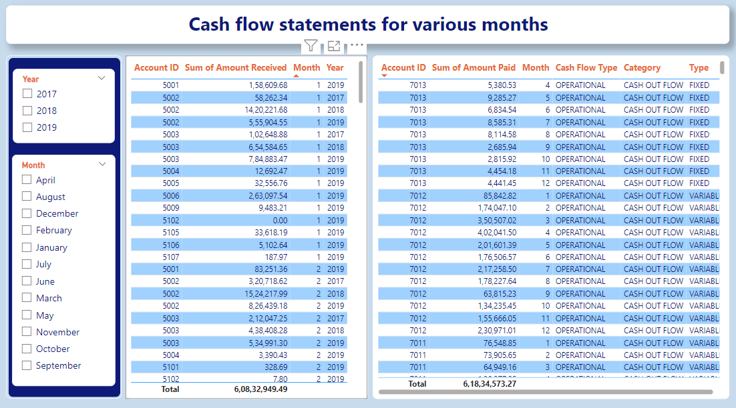

Slide 13
key conclusions
There is a net loss or negative profit of $1 million as a result of the total payments of $62 million exceeding the total income of $61 million. This suggests that over the studied period, the organization's expenses outpaced its income.
A difficult financial situation is indicated by the 1 million profit being negative. It is imperative that the fundamental causes of this shortfall be looked into and addressed. It can be necessary to implement cost-cutting, revenue-boosting, or operational optimization strategies.
Each transaction brings in about 4,000 units of money for the organization on average. In comparison, 3,000 pieces of money are typically paid for each transaction. This indicates a discrepancy in the typical amounts paid and received, necessitating additional research into the types of transactions, pricing schemes, and general financial efficacy.
27% of the total income is represented by the average amount paid annually. Knowing this percentage gives you an idea of how much of your money goes into payments. Tracking this indicator over time can assist in determining the organization's capacity to manage costs in relation to revenue and its long-term financial viability.

Slide 14
A review of the organization's financial plan is recommended in light of the negative profit and the apparent difference between average amounts received and paid. This could entail looking for ways to cut costs, looking into ways to increase revenue, and putting policies in place to boost overall financial effectiveness.
Effective cash flow management is essential, particularly when there are more payments than income. Prioritizing working capital optimization, securing advantageous terms for provider payments, and maintaining a balanced cash flow strategy should be the organizations' main priorities.
The company must to think about creating a thorough plan for long-term financial sustainability. To improve overall financial health, this may entail carrying out a thorough evaluation of spending, diversifying sources of income, and putting strategic plans into action.

Slide 15
Thank you

